Slide 1
Operating Systems
5. Synchronization
1

Slide 2
Synchronization
Many processes/threads interact (shared memory / message passing)
Results of interactions not guaranteed to be deterministic
Concurrent writes to the same address
Result depends on the order of operations
OS manage
Large number of resources
Common data structures
Need to provide good coordination mechanisms
Access to the data structures
Ensure consistency
Objective
Identify general synchronization problems
Provide OS support for synchronization

Slide 3
Example: Too Much Milk
Alice
3:00 Look in fridge - no milk 3:05 Leave for shop
3:10 Arrive at shop 3:15 Leave shop
3:20 Back home - put milk in fridge 3:25
Bob
Look in fridge - no milk Leave for shop
Arrive at shop Leave shop
Back home - put milk in fridge Oooops!
Problem: Need to ensure that only one process is doing something at a time (e.g., getting milk)

Slide 4
Example: Money Flies Away …
BALANCE: 2000 €
Bank thread A
Bank thread B
Read a := BALANCE a := a + 500
Write BALANCE := a
Read b:= BALANCE b := b – 200
Write BALANCE := b
Oooops!! BALANCE: 1800 €!!!!
Problem: need to ensure that each process is executing its critical section (e.g updating BALANCE) exclusively (one at a time)

Slide 5
Example: Print Spooler
If a process wishes to print a file
It adds its name in a Spooler Directory
The printer process
Periodically checks the spooler directory
Prints a file
Removes its name from the directory

Slide 6
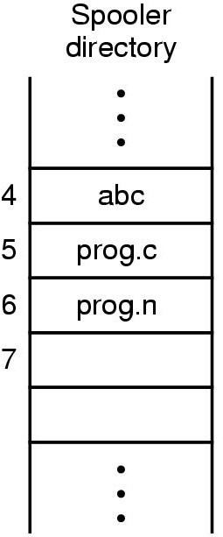


Example: Print Spooler
If any process wants to print a file it will execute the following code
Read the value of in in a local variable next_free_slot
Store the name of its file in the
next_free_slot
Increment next_free_slot
Store back in in
Next file to be printed
Shared Variables
Next free slot in the directory

Slide 7
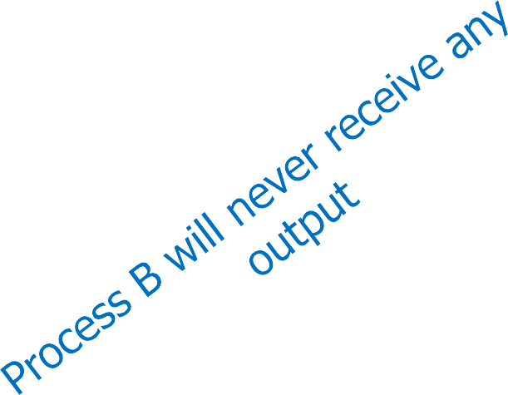
Example: Print Spooler
Let A and B be processes who want to print their files
Process A
Read the value of in in a
local variable next_free_slot
Store the name of its file in the next_free_slot
Increment next_free_slot
Store back in in
Process B
Read the value of in in a
local variable next_free_slot
Store the name of its file in the next_free_slot
3 .Increment next_free_slot
4. Store back in in
Time out
A.cpp
B.cpp
next_free_slot_{a} = 7
next_free_slot_{b} = 7
in = 8
in = 7

Slide 8
Example: Producer/Consumer Problem
An integer count that keeps track of the number of full buffers
Initially, count is set to 0
Count is incremented by the producer after it produces a new buffer
Count is decremented by the consumer after it consumes a buffer
Producer
while (true) {
/* produce an item and put in nextProduced */
while (counter == BUFFER_SIZE)
; // do nothing
buffer [in] = nextProduced; in = (in + 1) % BUFFER_SIZE;
counter++;
}

Slide 9
Example: Producer/Consumer Problem
An integer count that keeps track of the number of full buffers
Initially, count is set to 0
Count is incremented by the producer after it produces a new buffer
Count is decremented by the consumer after it consumes a buffer
Consumer:
while (true) {
while (counter == 0)
; // do nothing nextConsumed = buffer[out]; out = (out + 1) % BUFFER_SIZE;
counter--;
/* consume the item in nextConsumed */
}

Slide 10
Producer/Consumer Problem – Race Condition
counter++ could be implemented as
register1 = counter
register1 = register1 + 1
counter = register1
counter-- could be implemented as
register2 = counter
register2 = register2 – 1
count = register2
Consider this execution interleaving with “count = 5” initially:
S0: producer execute register1 = counter {register1 = 5}
S1: producer execute register1 = register1 + 1 {register1 = 6}
S2: consumer execute register2 = counter {register2 = 5}
S3: consumer execute register2 = register2 - 1 {register2 = 4}
S4: producer execute counter = register1
S5: consumer execute counter = register2
{count = 6 }
{count = 4}

Slide 11
Race Condition
Race condition
Several processes access and manipulate the same data concurrently
Outcome of the execution depends on the particular order in which the access takes place
Debugging is not easy → Most test runs will run fine
At any given time a process is either
Doing internal computation → no race conditions
Or accessing shared data that can lead to race conditions
Part of the program where the shared memory is accessed is called Critical Region
Races condition can be avoided
If no two processes are in the critical region at the same time

Slide 12
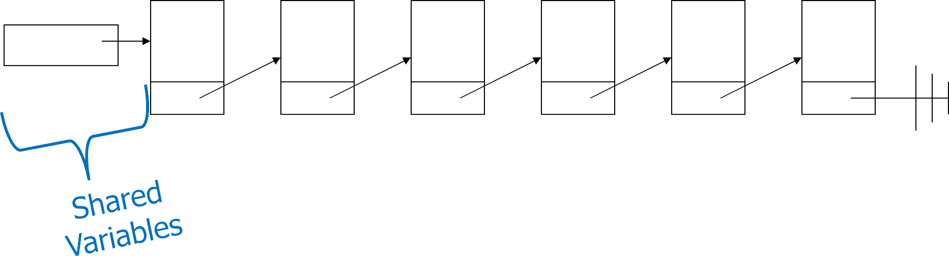
Examples of Race Condition
Adding node to a shared linked list
first
5
9
17
22
26
34

Slide 13
Critical-Section (CS) Problem
processes all competing to use some shared data / resource
Each process has a code segment, called critical section, in which the shared data is accessed
Problem: ensure that
Never two process are allowed to execute in their critical section at the same time
Access to the critical section must be an atomic action
Structure of process P_{i}:
repeat
entry section critical section
exit section remainder section
until false;

Slide 14
Critical-Section (CS) – Example
void threadRoutine()
{
int y, x, z; y = 3 + 5x;
y = Global_Var; y = y + 1; Global_Var = y;
…
…
}

Slide 15
Critical-Section (CS)
A enters critical section
A leaves critical section
Process A
B enters critical section
B blocked
Process B
T₁
T₂
T₃
T₄
B attempts to enter critical section
B leaves critical section
Mutual Exclusion
At any given time, only one process is in the critical section

Slide 16
Requirements: Critical-Section (CS) Problem solution
Informally, the following are the requirements of CS problem
No two processes may be simultaneously inside their critical sections
No assumptions may be made about the speed or the number of processors
No process running outside its critical section may block other processes
No process should have to wait forever to enter its critical section

Slide 17

Requirements: Critical-Section Problem
Mutual exclusion
Only one process at a time is allowed to execute in its critical section
Progress
Processes cannot be prevented forever from entering CS
Progress: Distinguish between
Fairness (no starvation): Every process makes progress
Bounded waiting
Deadlock freedom: At least one process can make progress
Process running outside the critical section should not have influence
Assumptions
No process stays forever in CS
No assumption on the number of processors
No assumption on actual speed of processes

Slide 18
Requirements: Critical-Section Problem
Mutual exclusion
Progress
Bounded waiting
Before request by a process to enter its critical section is granted
A bound must exist on the number of times that other processes are allowed to enter their critical sections

Slide 19
Software Solution – Lock Variables
Before entering a critical section a process should know if any other is already in the critical section or not
Consider having a FLAG (also called lock)
FLAG = FALSE
A process is in the critical section
FLAG = TRUE
No process is in the critical section
// wait while someone else is in the
// critical region
while (FLAG == FALSE);
// stop others from entering critical region
FLAG = FALSE;
critical_section();
// after critical section let others enter
//the critical region
FLAG = TRUE;
noncritical_section();

Slide 20
Lock Variables
Process 1
1.while (FLAG == FALSE);
2.FLAG = FALSE;
Process 2
1.while (FLAG == FALSE);
FLAG = FALSE
FLAG = FALSE
FLAG = TRUE
FLAG = FALSE
FLAG = TRUE
1.while (FLAG == FALSE);
22.. FLAG = FALSE;
3.critical_section();
3.critical_section();
4.FLAG = TRUE;
5.noncritical_section();
Timeout
No two processes may be simultaneously inside their critical sections
Process 2 ‘s Program counter is at Line 2
Process 2 Busy Waits
Process 1 forgot that it was Process 2 turn

Slide 21
Lock Variables
// wait while someone else is in the
// critical region
while (FLAG == FALSE);
// stop others from entering critical region
FLAG = FALSE;
critical_section();
// after critical section let others enter
//the critical region
FLAG = TRUE;
noncritical_section();
Algorithm does not satisfy critical section requirements
– Progress is ok, but does NOT satisfy mutual exclusion

Slide 22
Software Solution – Strict Alternation
We need to remember “Who’s turn it is?”
If its Process 1’s turn then Process 2 should wait
If its Process 2’s turn then Process 1 should wait
Process 1
while(TRUE)
{
// wait for turn while (turn != 1); critical_section(); turn = 2;
noncritical_section();
}
Process 2
while(TRUE)
{
// wait for turn while (turn != 2); critical_section(); turn = 1;
noncritical_section();
}

Slide 23
Strict Alternation
Process 1
While(1)
1.while (Turn != 1);
Process 2
While(1)
1.while (Turn != 2);
1.while (Turn != 2);
Turn = 1
Turn = 1
Turn = 2
2.critical_section();
22.. critical_section();
3.Turn = 2; 4.noncritical_section();
3.Turn = 1; 4.noncritical_section();
Timeout
Only one Process is in the Critical Section at a time
Process 2 ‘s Program counter is at Line 2 Process 1 Busy Waits
Process 2 Busy Waits

Slide 24
Strict Alternation
Process 1
while(TRUE)
{
// wait for turn while (turn != 1); critical_section(); turn = 2;
noncritical_section();
}
Process 2
while(TRUE)
{
// wait for turn while (turn != 2); critical_section(); turn = 1;
noncritical_section();
}
What is the problem with strict alteration?
– Satisfies mutual exclusion, but not progress

Slide 25
Strict Alternation
Turn = 1
Process 1
while(TRUE)
{
// wait for turn while (turn != 1); critical_section(); turn = 2; noncritical_section();
}
Process 1
Process 2
while(TRUE)
{
// wait for turn while (turn != 2); critical_section(); turn = 1; noncritical_section();
}
– Runs, Enters its critical section, Exits critical section, Sets turn to 2
Process 1 is now in its non-critical section
Assume this non-critical procedure takes a long time
Process 2, which is a much faster process, now runs
Once it has left its critical section, sets turn to 1
Process 2 executes its non-critical section very quickly and returns to the top of the procedure

Slide 26
Strict Alternation
Turn = 1
Process 1
while(TRUE)
{
// wait for turn while (turn != 1); critical_section(); turn = 2; noncritical_section();
}
Process 2
while(TRUE)
{
// wait for turn while (turn != 2); critical_section(); turn = 1; noncritical_section();
}
Process 1 is in its non-critical section
Process 2 is waiting for turn to be set to 2
– There is no reason why process 2 cannot enter its critical region as process 1 is not in its critical region

Slide 27
Strict Alternation
Process 1
while(TRUE)
{
// wait for turn while (turn != 1); critical_section(); turn = 2;
noncritical_section();
}
Process 2
while(TRUE)
{
// wait for turn while (turn != 2); critical_section(); turn = 1;
noncritical_section();
}
Problem with strict alteration
Violation: No process running outside its critical section may block other processes
This algorithm requires that the processes strictly alternate in entering the critical section
Taking turns is not a good idea if one of the processes is slower

Slide 28
Yet Another Solution
Strick alternation
Although it was Process 1’s turn
But Process 1 was not interested
Solution: Remember whether a process is interested in CS or not
Replace int turn with bool interested[2]
For example interested[0] = FALSE → Process 0 is not interested
Process 0
while(TRUE)
{
interested[0] = TRUE;
// wait for turn while(interested[1]!=FALSE); critical_section(); interested[0] = FALSE; noncritical_section();
}
Process 1
while(TRUE)
{
interested[1] = TRUE;
// wait for turn while(interested[0]!=FALSE); critical_section(); interested[1] = FALSE; noncritical_section();
}

Slide 29
Yet Another Solution
Process 0 |  | Process 1
while(TRUE) { interested[0] | = TRUE; | while(TRUE) { interested[1] = TRUE;
while(interested[1]!=FALSE);
Timeout
e(interested[0]!=FALSE);
whil
DEADLOCK

Slide 30
Peterson’s Algorithm
Combine previous two algorithms
– int turn with bool interested
Process P_{i}
while(TRUE)
{
interested[i] = TRUE; turn = j;
// wait
while(interested[j]==TRUE && turn == j ); critical_section();
interested[i] = FALSE; noncritical_section();
}

Slide 31
Peterson’s Algorithm
Process 0
while(TRUE)
{
interested[0] = TRUE; turn = 1;
// wait
while(intere F
&&
T
== 1 );
sted[1]==TRUE && turn
critical_section(); interested[0] = FALSE; noncritical_section();
Timeout
}
Process 1
while(TRUE)
{
interested[1] = TRUE; turn = 0;
// wait
while(interest _{F}
T && T
0 );
&&
T
ed[0]==TRUE && turn ==
critical_section(); interested[1] = FALSE; noncritical_section();
}
5-Synchronization
31

Slide 32
Peterson’s Algorithm
Process 0
while(TRUE)
{
interested[0] = TRUE; turn = 1;
// wait while(intere
T
&&
F == 1 );
sted[1]==TRUE && turn
critical_section();
interested[0] = FALSE; noncritical_section();
}
Process 1
while(TRUE)
{
interested[1] = TRUE; turn = 0;
Can not be TRUE at the
Timeout
same time.
Thus used to break tie
// wait
while(intere F
&&
T
T && T
== 0 );
sted[0]==TRUE && turn
critical_section(); interested[1] = FALSE; noncritical_section();
}
5-Synchronization
32

Slide 33
Lamport’s Bakery Algorithm (For n processes)
Idea
Before entering its critical section, each process receives a number
Holder of the smallest number enters the critical section
Fairness
No deadlock
If processes P_{i} and P_{j} receive the same number
if i <j, then P_{i} is served first
else P_{j} is served first
While processes are trying to enter CS
The numbering scheme generates numbers in increasing order of enumeration; i.e., 1,2,3,4,5

Slide 34
Lamport’s Bakery Algorithm
Peterson’s algorithm solves the critical-section problem for two processes
– For multiple processes, bakery algorithm is used
Shared var choosing: array [0..n – 1] of boolean (init false); number: array [0..n – 1] of integer (init 0),
Process P_{i}
1: repeat
2: choosing[i] := true;
3: number[i] := max(number[0],number[1], …,number [n – 1])+1; 4: choosing[i] := false;
5: for j := 0 to n – 1 do begin
6: while choosing[j] do no-op;
7: while number[j] != 0 and (number[j],j) < (number[i], i) do
8: no-op;
9: end;
10: critical section
11: number[i] := 0;
12: remainder section
13: until false;

Slide 35
CS Problem: Software-based Solutions
Peterson and Bakery algorithms solve critical section problem
These algorithms are not used in practice
Mutual exclusion depends on the order of steps in the software based algorithms
However, modern Compilers often reorder instructions to enhance performance

Slide 36
Mutual Exclusion: Hardware Support
Interrupt Disabling
A process runs until it invokes an operating-system service or until it is interrupted
Disabling interrupts guarantees mutual exclusion
while(true){
/* disable interrupts */ critical section
/* enable interrupts */ remainder section
}
Disadvantage
Processor is limited in its ability to interleave programs
Multiprocessors: Disable interrupts on one processor will not guarantee mutual exclusion
User programs cannot directly disabled interrupts

Slide 37
Mutual Exclusion: Other Hardware Support
Special Machine Instructions
Performed in a single instruction cycle: Reading and writing in one atomic step
Not subject to interference from other instructions
Uniprocessor system: Executed without interrupt
Multiprocessor system: Executed with locked system bus

Slide 38
Test and Set (TSL)
Test and Set Instruction
1: boolean testset (int & i) {
Test and Set Instruction
1: boolean testset (Boolean *target) {
2:
3:
4:
5:
6:
7: }
if (i == 0) { i = 1;
return false;
}
else return true;
2:
3:
4:
5: }
boolean rv = *target;
*target = true;
return rv;
Atomic processor instructions
Idea: Only one process at a time succeeds to set lock=1

Slide 39
Solution with TSL
Structure for Pi (‘lock’ is set to false)
do {
while ( TestAndSet(lock) ) ;
Critical Section
lock = false;
Remainder Section
}

Slide 40
Solution with TSL
Is the TSL-based solution good?
No
Mutual Exclusion: Satisfied
Progress: Satisfied
Bounded Waiting: Not satisfied

Slide 41
Solution with Swap
Structure for Pi
‘key’ is local and set to false
do {
key = true;
while (key == true) swap(lock,key);
Critical Section
lock = false;
Remainder Section
}

Slide 42
Solution with swap
Is the swap-based solution good?
No
Mutual Exclusion: Satisfied
Progress: Satisfied
Bounded Waiting: Not satisfied

Slide 43
Mutual Exclusion Using Machine Instructions
Advantages
Applicable to any number of processes on single or multiple CPUs sharing main memory
It is simple and therefore easy to verify Disadvantages
Busy-waiting consumes processor time
Starvation is possible
A process leaves a CS
More than one process is waiting
Deadlock possible if used in priority-based scheduling systems: Ex. scenario
Low priority process has the critical region
Higher priority process needs it
The higher priority process will obtain the CPU to wait for the critical region

Slide 44
Avoiding Starvation
Bounded waiting with Test and Set instruction
do {
waiting[i] = TRUE; key = TRUE;
while (waiting[i] && key) key = TestAndSet(&lock);
waiting[i] = FALSE;
// critical section j = (i + 1) % n;
while ((j != i) && !waiting[j]) j = (j + 1) % n;
if (j == i) lock = FALSE;
else
waiting[j] = FALSE;
// remainder section
} while (TRUE);
Notes:
Initialization: Initially, j is set to (i + 1) % n, where n is the total number of processes. This ensures that j starts at the next process in the sequence after the current process i.
While Loop:
The loop condition is while ((j != i) && !waiting[j]).
j iterates through the processes, starting from the next process after the current process (i). It continues until either:
j becomes equal to i (signifying that all other processes have been checked and no other process is waiting), or
It finds a process (j) that is currently waiting to access the critical section (!waiting[j]).
Decision based on the Loop Exit:
If j becomes equal to i (j == i), it implies that all other processes have been checked, and none of them are waiting. In this case, it means that the current process can safely release the lock (lock = FALSE) and exit the critical section.
If j is different from i, it means a waiting process (j) has been found. In this case, the current process changes the status of this waiting process by setting waiting[j] = FALSE, allowing that process to know it's no longer waiting.

Slide 45
Priority Inversion
Consider three processes
Process L with low priority that requires a resource R
Process H with high priority that also requires a resource R
Process M with medium priority
If H starts after L has acquired resource R
H has to wait to run until L relinquishes resource R
Now when M starts
M is higher priority unblocked process, it will be scheduled before L
Since L has been preempted by M, L cannot relinquish R
M will run until it is finished
Then L will run - at least up to a point where it can relinquish R
Then H will run
Priority inversion: Process with the medium priority ran before a process with high priority

Slide 46
Priority Inheritance
If high priority process has to wait for some resource shared with an executing low priority process
Low priority process is temporarily assigned the priority of the highest waiting priority process
Medium priority processes are prevented from pre-empting (originally) low priority process avoiding priority inversion

Slide 47
Semaphores
Higher-level synchronization construct
– Designed by Edsger Dijkstra in 1960’s

Slide 48

Semaphores
Synchronization variable accessed by
System calls of the operating system
Associated with a queue of blocked processes
Accessible via atomic wait() and signal() operations
Originally called P() and V()
wait(): Process blocks until a signal is received
signal(): Another process can make progress: Process in the queue, next process calling wait()
Different semaphore semantics possible
Binary: Only one process at a time makes progress
General (counting): n processes at a time make progress

Slide 49
Binary Semaphore
Wait: Process blocks if state of semaphore is 0
Signal: Unblocks a process or sets the state of the semaphore to 1
wait () / P() {
while S <= 0 ; // no-op S--;
}
signal () / V() { S++;
}
An atomic operation that waits for semaphore to become positive then decrements it by 1
An atomic operation that increments semaphore by 1
How to avoid busy waiting?

Slide 50
Busy-waiting
Problem with hardware and software based implementations
If one thread already has the lock, and another thread T wants to acquire the lock
Acquiring thread T waste CPU’s time by executing the Idle loop
To avoid CPU time
If a thread (process) T cannot enter critical section
T’s status should be changed from Running to Blocked
T should be removed from the ready list and entered in a block list
When T enters critical section
T’s status should be changed from Blocked to Ready/Running
T should be entered in the ready list

Slide 51


Busy-waiting
Dispatch
Ready
Running
Can Enter the Critical Section
Cannot Enter the Critical Section
Blocked
No CPU time wastage

Slide 52
Sleep/Block and Wakeup Implementation
sleep()/block() and wakeup() can be two system calls
When a process P_{i} determines that it can not enter the CS it calls
sleep()/block()
– Pi entered in the block list
When the other process finishes with the CS, it wakes up P_{i},
wakeup(P_{i})
– P_{i} entered in the ready list
wakeup() takes a single input parameter, which is the ID of the process to be unblocked

Slide 53
Binary Semaphore
Wait: Process blocks if state of semaphore is 0
Signal: Unblocks a process or sets the state of the semaphore to 1
struct bin_sem_t {
enum {zero, one} value; queueType queue;
/* Can be linked list of PCB */
};
int wait(bin_sem_t s) {
if (s.value==1)
s.value=0;
else{
/* block and place current process in s.queue */
state(current) = BLOCKED
append(s.queue, current)
int signal(bin_sem_t s) {
if (isempty(s.queue)) s.value=1;
else{
/* unblock and remove first process from s */
p=pop(s.queue);
state(p) = READY/RUNNING
}
}
}
}

Slide 54
Counting Semaphore
Count: Determines no. of processes that can still pass semaphore
Wait: Decreases count and blocks if count is < 0
Signal: Unblocks a process or increases count
struct sem_t {
int count; queueType queue;
};
int signal(sem_t s) { s.count++;
if (s.count ≤ 0){
/* unblock and remove first process from s */
p=pop(s.queue);
state(p) = RUNNING/READY
int wait(sem_t s) { s.count--;
if (s.count < 0)
/* block and place current process in s.queue */
state(current) = BLOCKED
}
}
append(s.queue, current)
}
}
52

Slide 55
Critical Section Using Semaphores
Shared var mutex
of semaphore (init =1)
Process P_{i}:
1: repeat
2: wait(mutex)
3: critical section
4: signal(mutex);
5: remainder section
6: until false;
Properties:
Again simple
No busy waiting
Fair if queues of semaphores are implemented fair

Slide 56
Process Synchronization
Execute statement B in Pj only after statement A has been executed in Pi
Use semaphore S initialized to 0
Pi Pj
 
A wait(S) signal(S) B

Slide 57
Process Synchronization
Give a semaphore based solution for the following problem:
Statement S1 in P1 executes only after statement S2 in P2 has executed, and statement S2 in P2 should execute only after statement S3 in P3 has executed.

Slide 58
Process Synchronization
P1 P2 P3
  
S1 S2 S3
  

Slide 59
Solution
Semaphore A=0, B=0;
P1 P2 P3
  
wait(A) wait(B) S3
S1 S2 signal(B)
signal(A)
  

Slide 60
Bad Use of Semaphores Can Lead to Deadlocks!
Let S and Q be two semaphores initialized to 1
P₀
P₁
1
3
wait(S);
wait(Q);
 signal(S); signal(Q):
2
4
wait(Q);
wait(S);
 signal(Q); signal(S);

Slide 61
Synchronization Problems
Critical section synchronization very common
Problems
Synchronization on many variables becomes increasingly complicated
Deadlock because of bad programming likely to happen
Idea: Understand useful synchronization patterns that match IPC patterns
Consumers/Producer problem
High degree of concurrency by decoupling of tasks
Dining Philosophers
Coordinate access to resources
Readers Writers Problem
Coordinate access to shared data structures

Slide 62

Producer/Consumer Problem Revisited
Also known as bounded buffer problem
Producer
1 ...
N
Consumer
Overall problem description
A buffer can hold N items
Producer pushes items into the buffer
Consumer pulls items from the buffer
Producer needs to wait when buffer is full
Consumer needs to wait when the buffer is empty

Slide 63
Producer/Consumer Problem Revisited
int BUFFER_SIZE = 100; int count = 0;
void producer(void) { int item;
while(TRUE) {
produce_item(&item);
if(count == BUFFER_SIZE) sleep ();
enter_item(item);
count++;
if(count == 1) wakeup(consumer);
}
}
void consumer(void) { int item;
while(TRUE) {
if(count == 0) sleep ();
remove_item(&item);
count--;
if(count == BUFFER_SIZE - 1) wakeup(producer);
consume_item(&item);
1
1
Producer must wait for consumer to empty buffers
3
2
Consumer must wait for producer to fill buffers
2
3
A thread can manipulate buffer queue at a time
2
3
1
}
}
5-Synchronization
58

Slide 64
Producer/Consumer Problem Revisited
Synchronization between producer and consumer
– Use of three separate semaphores
Producer must wait for consumer to empty buffers, if all full
Semaphore empty initialized to the value N
Consumer must wait for producer to fill buffers, if none full
Semaphore full initialized to the value 0
Producer/consumer can manipulate buffer queue at a time
Semaphore mutex initialized to the value 1

Slide 65
Producer/Consumer Problem Revisited
Semaphore empty initialized to the value N
Semaphore full initialized to the value 0
Semaphore mutex initialized to the value 1
Producer:
void producer(void) { int item; while(TRUE) {
produce_item(&item); wait (empty); wait(mutex); enter_item(item); signal(mutex); signal(full);
}
}
Consumer:
void consumer(void) { int item; while(TRUE) {
wait(full); wait(mutex); remove_item(&item); signal(mutex); signal(empty); consume_item(&item);
}
}

Slide 66
Changing Order of Semaphores
Producer:
void producer(void) { int item; while(TRUE) {
produce_item(&item); wait (mutex); wait(empty); enter_item(item); signal(mutex); signal(full);
}
}
Consumer:
void consumer(void) { int item; while(TRUE) {
wait(full); wait(mutex); remove_item(&item); signal(mutex); signal(empty); consume_item(&item);
}
}
DEADLOCK

Slide 67
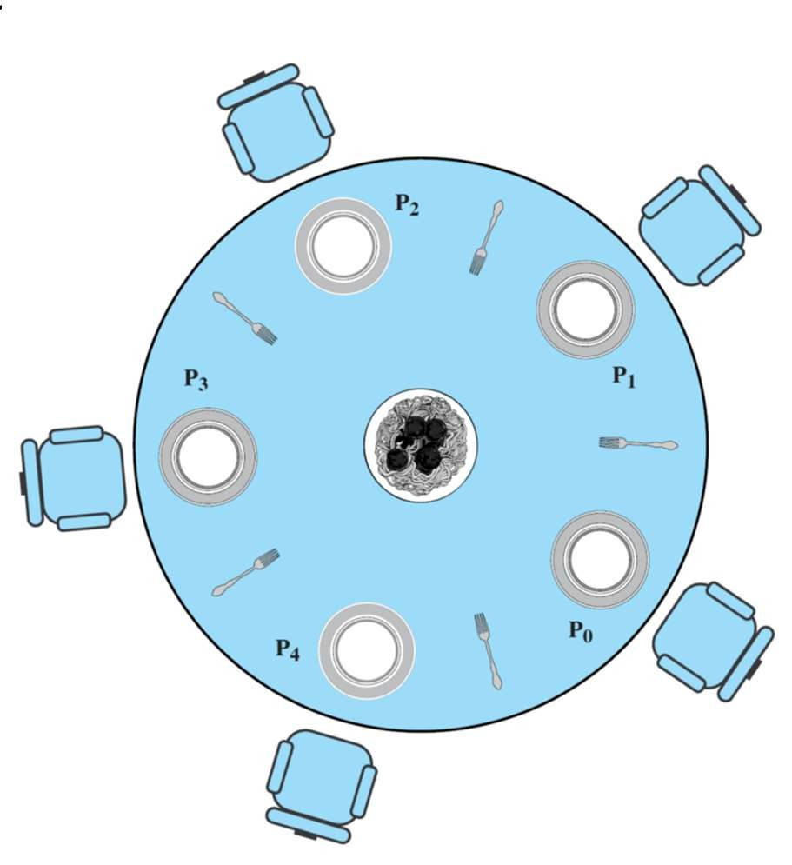
Dining Philosophers Problem [E.W. Dijkstra, 1965]
Simplest form of the resource allocation problem
Intuition:
Philosophers ~ Processes which aim to execute code
Food ~ code which requires exclusive access to resources
Forks ~ conflicts on shared resources
Hungry philosophers
Try to exclusively acquire forks shared with neighbors
Eat after they have aquired both forks
Release forks after eating
Think if not interested to eat

Slide 68
Dining Philosophers Problem: States and Properties
Goal
No deadlocks
Hungry philosophers will eventually be able to eat
Think
Hungry
Eat
States of a philosopher

Slide 69
Dining Philosophers Problem Using Semaphores
Represent each fork with a semaphore
Semaphore fork[5] initialized to 1
Structure of Philosopher i
do {
wait ( fork[i] );
wait ( fork[ (i + 1) % 5] );
// eat
signal ( fork[i] );
signal (fork[ (i + 1) % 5] );
// think
} while (TRUE);
Solution guarantees that no two neighbors eat simultaneously
Deadlock can be occur

Slide 70
Semaphores Summary
Semaphores can be used to solve any of traditional synchronization problems
Semaphore have some drawbacks
They are essentially shared global variables
Can potentially be accessed anywhere in program
No connection between the semaphore and the data being controlled by the semaphore
Used both for critical sections (mutual exclusion) and coordination (scheduling)
No control or guarantee of proper usage
Sometimes hard to use and prone to bugs
Another approach: Use programming language support

Slide 71
Monitors
Goal: Avoid problems of managing multiple semaphores
Monitor is a programming language construct (not OS)
Controls access to shared data
Synchronization code added by compiler, enforced at runtime
monitor name
{
// shared variable
procedure … | P1 | ( … ) {
}
…
procedure | PN | (…){
…
}
initialization (…) {
…
}
}

Slide 72
Monitors
A monitor guarantees mutual exclusion
monitor name
{
// shared variable
Only one thread can execute any monitor procedure at any time
The thread is “in the monitor”
If a second thread invokes a monitor procedure when a first thread is already executing one, it blocks
So the monitor has to have a wait queue…
If a thread within a monitor blocks, another one can enter
procedure … | P1 | ( … ) {
}
…
procedure | PN | (…){
…
}
initialization (…) |  |  | {
…
}
}

Slide 73
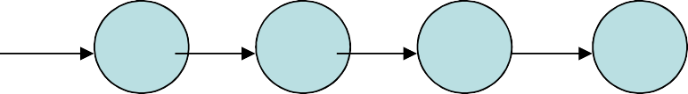
Monitors
shared data
P_{i}
P_{j}
P_{k}
P_{l}
…
Operations
Initialization Code

Slide 74
Monitors
A monitor has four components
Initialization
Share (private) data
Monitor procedures
Monitor entry queue
A monitor looks like a class with
Constructors, private data and methods
Only major difference is that classes do not have entry queues

Slide 75
Mutual Exclusion With a Monitor
monitor mutual_exclusion{
procedure CS();
Critical Section
end;
}
Process P_{i}: 1: REPEAT
2:
3:
CS();
Remainder Section
4: UNTIL false;

Slide 76
Monitors Example
Monitor account { double balance;
double withdraw(amount) { balance = balance – amount; return balance;
}
}
T_{l}
T₂
Threads are blocked while waiting to get into monitor
When first thread exists, another can enter

Slide 77
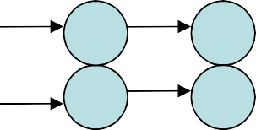

Condition Variables in Monitors
Similar concept to semaphores
Condition variable associated with a queue
x y
P_{i} P_{j}
P_{l} P_{k}
P_{i} P_{j} P_{k} P_{l}
condition x; // declaration
wait()
Process which invokes this operation is blocked
…
Operations
signal()
A blocked process can resume execution
– If no process issue x.wait () on variable x, then it has no effect on the variable
Initialization Code

Slide 78
Producer/Consumer Problem Revisited
monitor ProducerConsumer { int itemCount; condition full, empty;
procedure initialization( ){ itemCount = 0;
}
procedure add(item) {
if (itemCount == BUFFER_SIZE) full.wait( );
putItemIntoBuffer(item); itemCount = itemCount + 1;
if (itemCount == 1) empty.signal();
}
procedure remove() {
if (itemCount == 0) empty.wait( );
item = removeItemFromBuffer(); itemCount = itemCount - 1;
if (itemCount == BUFFER_SIZE - 1) full.signal( );
return item;
}
procedure producer() {
while (true) {
item = produceItem(); ProducerConsumer.add(item);
}
}
procedure consumer() {
while (true) {
item = ProducerConsumer.remove(); consumeItem(item);
}
}
}

Slide 79
Signal Semantics
What happens if P executes x.signal() & has still code to execute?
Two possibilities
Hoare monitors (Concurrent Pascal, original)
Signal and wait: P either waits for Q to leave the monitor or waits for some other condition
The condition that Q was anticipating is guaranteed to hold
if (empty) wait(condition);
Mesa monitors (Mesa, Java)
Signal and continue: Q either waits until P leaves the monitor or for some other condition
Condition is not necessarily true when Q runs again
while (empty) wait(condition);

Slide 80
Condition Variables vs. Semaphores
Semaphore
Can be used anywhere in a program, but should not be used in a monitor
wait() does not always block the caller (i.e., when the semaphore counter is greater than zero)
signal() either releases a blocked thread, if there is one, or increases the semaphore counter
If signal() releases a blocked thread, the caller and the released thread both continue
Condition variables
Can only be used in monitors
wait() always blocks the caller
signal() either releases a blocked thread, if there is one, or the signal is lost as if it never happens
If signal() releases a blocked thread. Only one of the caller or the released thread can continue, but not both

Slide 81
Dining Philosophers Problem Revisited
monitor DiningPhilosophers {
enum {THINK,HUNGRY,EAT) state[5];
condition self [5];
void test (int i) {
if ((state[(i+4)%5] != EATING) && (state[i] == HUNGRY) && (state[(i+1)%5] != EATING)) {
state[i] = EATING ; self[i].signal() ;
}
}
void pickup (int i) { state[i] = HUNGRY; test(i);
if (state[i] != EATING) self [i].wait();
}
void putdown (int i) { state[i] = THINKING;
// test left & right neighbors test((i + 4) % 5);
test((i + 1) % 5);
}
initialization_code() {
for (int i = 0; i < 5; i++) state[i] = THINKING;
}
Function of Philosopher i
Void philosopher(int i) { while (true) {
DiningPhilosophers.pickup (i);
// EAT DiningPhilosophers.putdown (i);
// THINK
}
}
No deadlock but sta} rvation is possible

Slide 82
Condition Variables and Locks
Condition variables are also used without monitors in conjunction with blocking locks
procedure( ) { Acquire(lock);
/* Do something including signal and wait*/ Release(lock);
}
A monitor is “just like” a module whose state includes a condition variable and a lock
Difference is syntactic; with monitors, compiler adds the code
It is “just as if” each procedure in the module calls acquire() on entry and release() on exit
But can be done anywhere in procedure, at finer granularity

Slide 83
Condition Variables and Locks – Example
Lock lock;
Condition cond;
int | AddToQueue() {
 | lock.Acquire(); | // | Lock before using shared data
 | put item on queue; | // | Ok to access shared data
 | cond.signal();
 | lock.Release(); | // | Unlock after done with shared data
}
int | RemoveFromQueue() {
 | lock.Acquire();
 | while nothing on queue
 | cond.wait(&lock); //Atomically release lock and block until |  |  | signal
 | //Automatically re-acquire lock before it |  |  | returns
 | // Difference in syntax, e.g., wait(cond, |  |  | lock)
 | remove item from queue;
 | lock.Release();
 | return item;
}

Slide 84

Any Question So Far?

